Slide 1
STEGANOGRAPHY menu-based project
(Team-40) Team Member
1.Aditya pal
2.Prabal Srivastava
3.Devasheesh
4.Vikas Chaudhary
5.Tanishq Rastogi

Slide 2
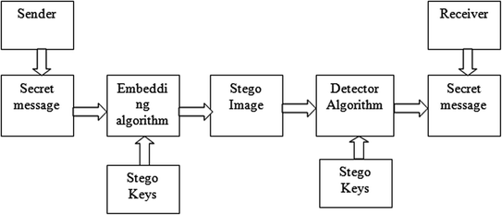
STEGANOGRAPHY

Slide 3
FOUR TYPES OF STEGANOGRAPHY
IMAGE STEGANOGRAPHY
TEXT STEGANOGRAPHY
AUDIO STEGANOGRAPHY
VIDEO STEGANOGRAPHY

Slide 4
IMAGE STEGANOGRAPHY (Using least significant bit algorithm ) [by tanishq]

Slide 5
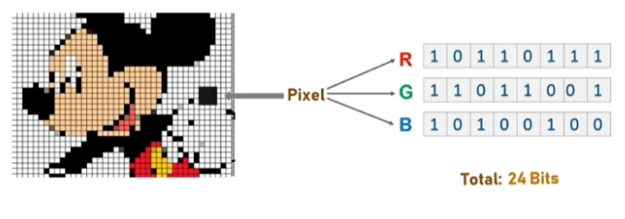
LEAST SIGNIFICANT BIT ALGORITHM

Slide 6
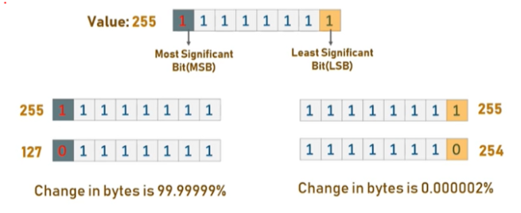

Slide 7
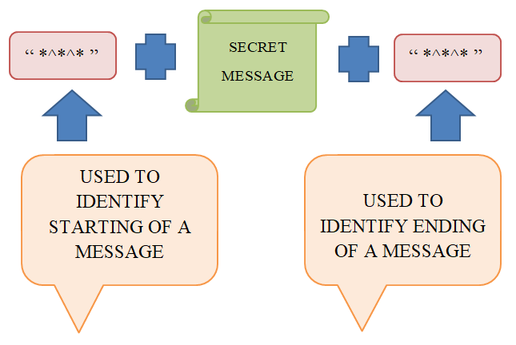
BASIC ALGORITHM

Slide 8
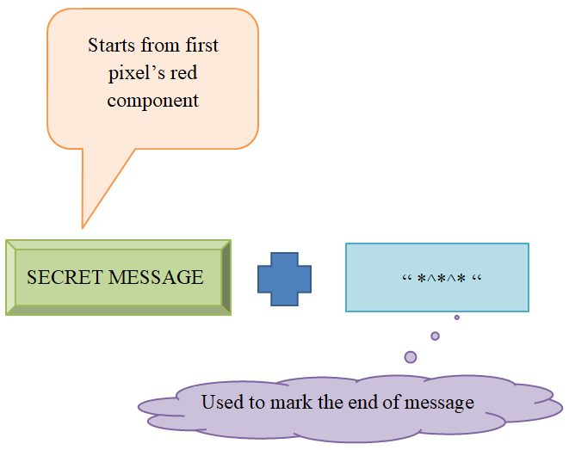
MODIFIED ALGORITHM

Slide 9
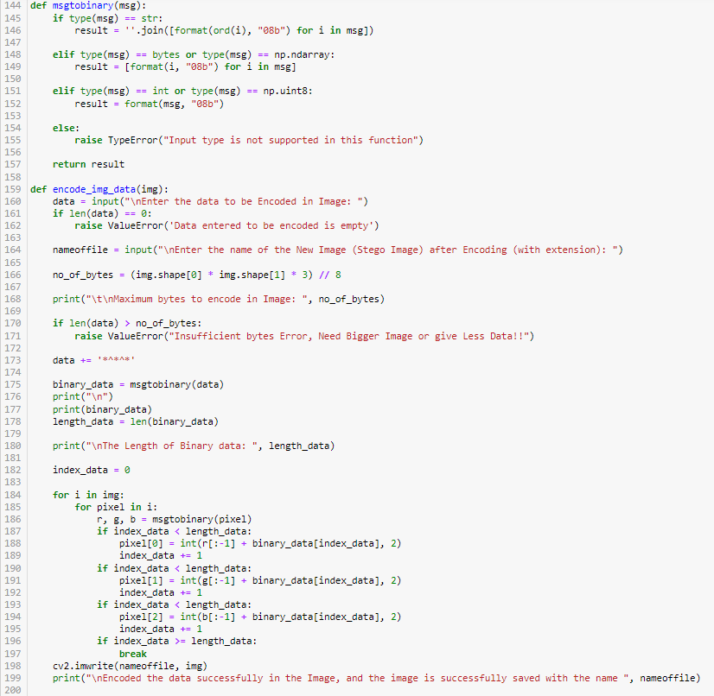
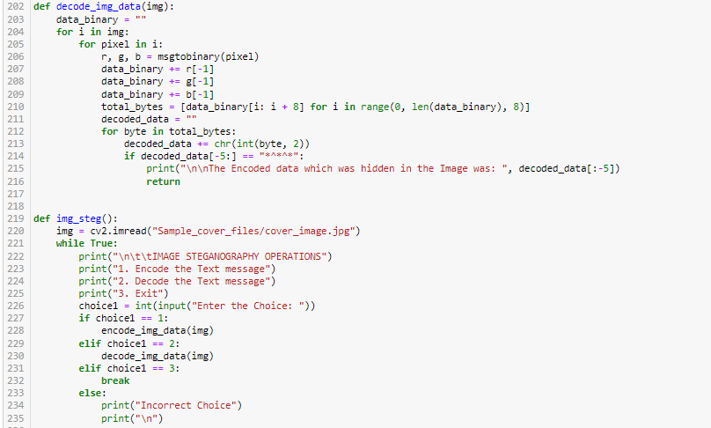
ENCODE AND DECODE

Slide 10
TEXT STEGANOGRAPHY [by Aditya pal]

Slide 11
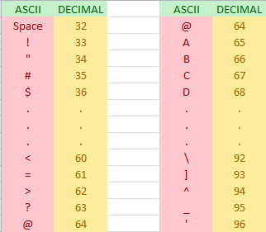

Slide 12
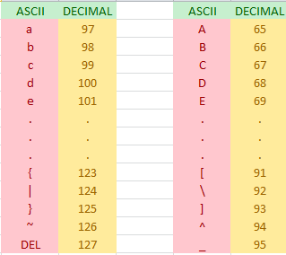

Slide 13
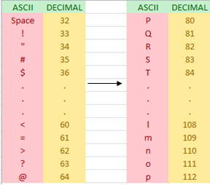

Slide 14
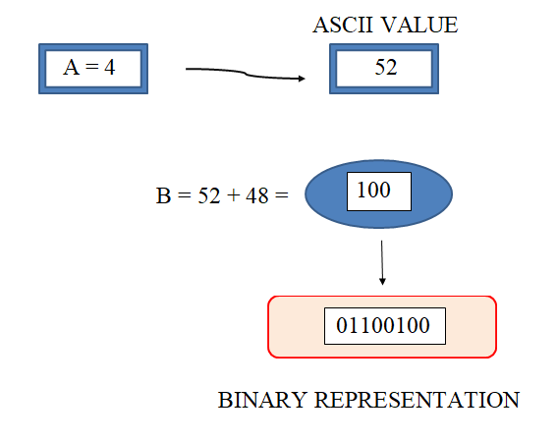
EXAMPLE 1

Slide 15
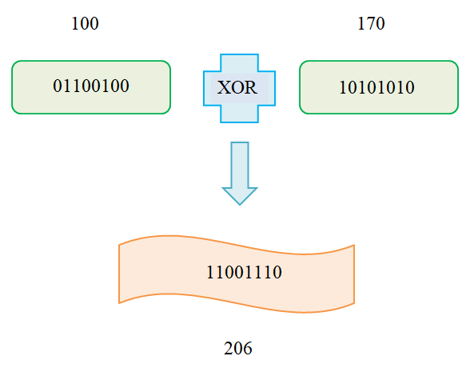

Slide 16
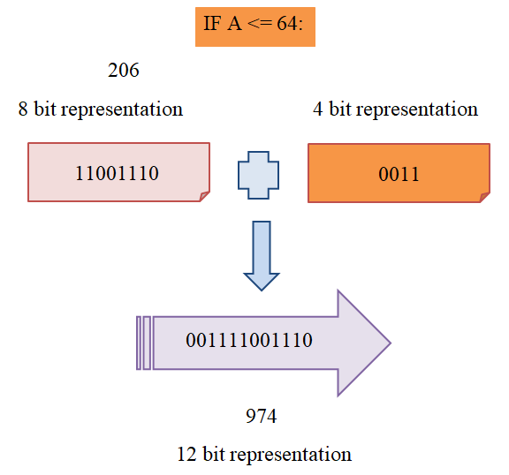

Slide 17
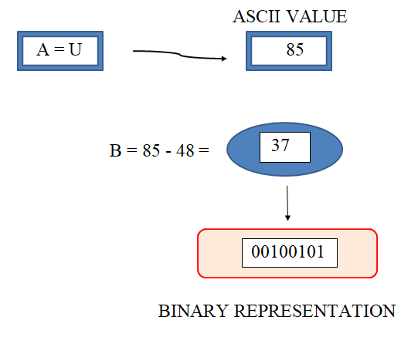
EXAMPLE 2

Slide 18
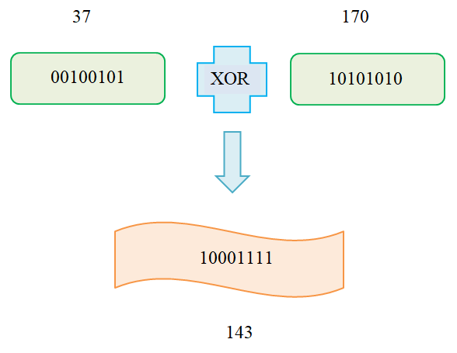

Slide 19
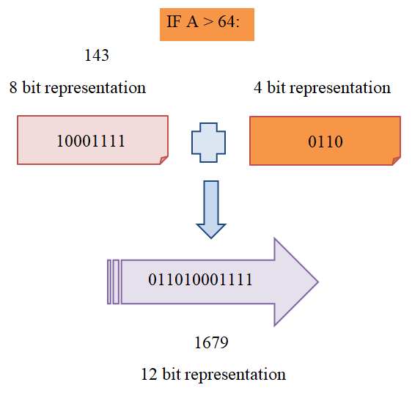

Slide 20
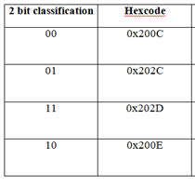
ZERO WIDTH CHARACTER

Slide 21
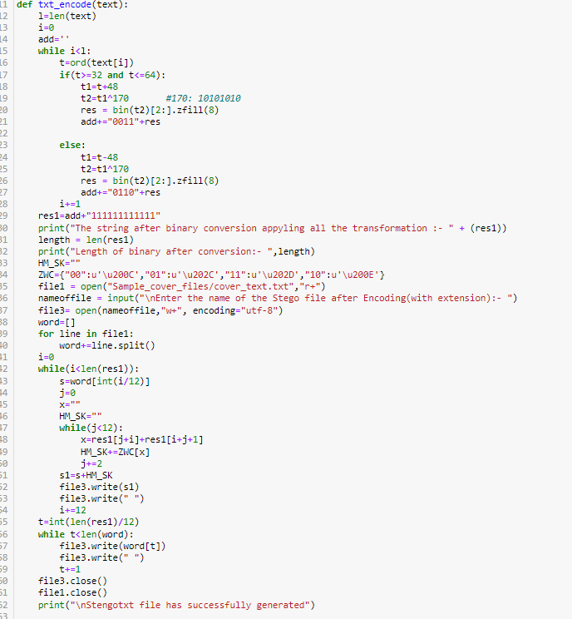
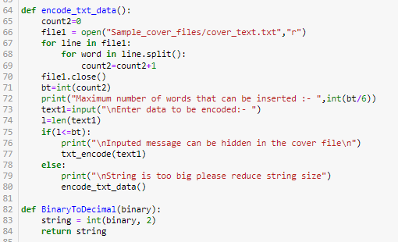
ENCODE

Slide 22
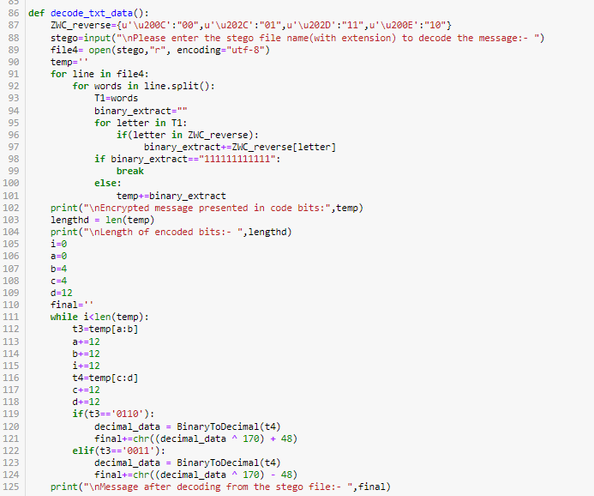
DECODE

Slide 23
AUDIO STEGANOGRAPHY (LSB MODIFICATION ) [by devasheesh]

Slide 24
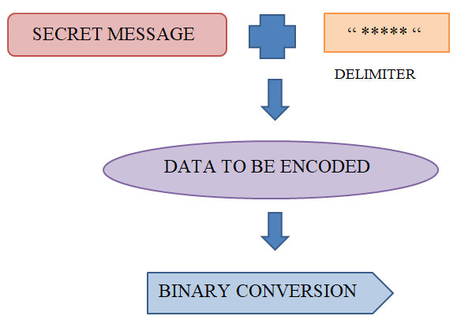

Slide 25
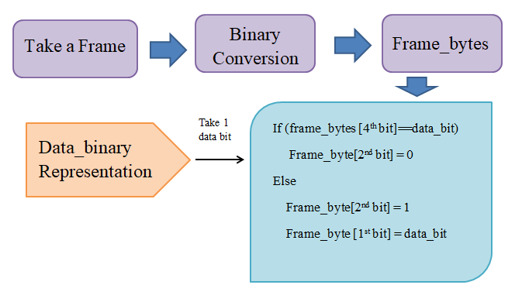

Slide 26
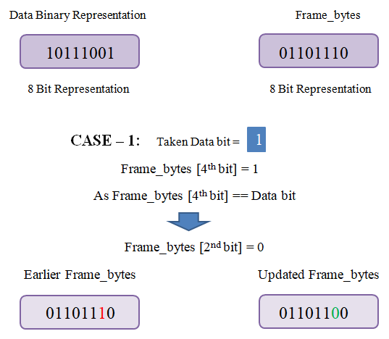

Slide 27
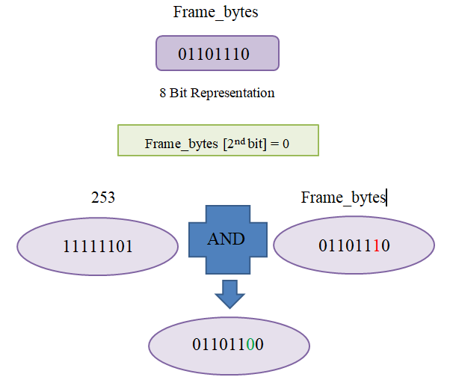

Slide 28
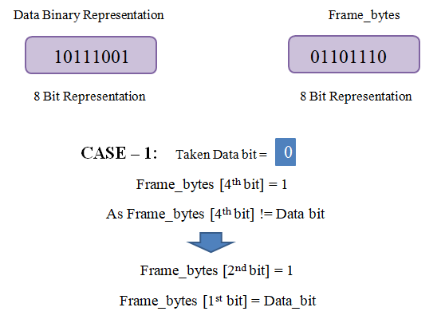

Slide 29
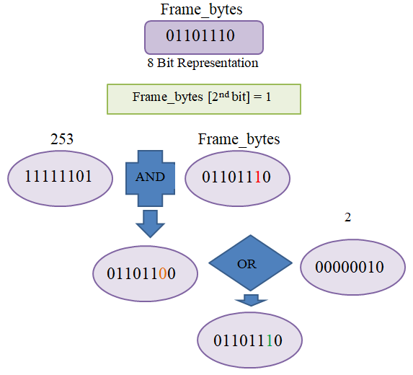

Slide 30
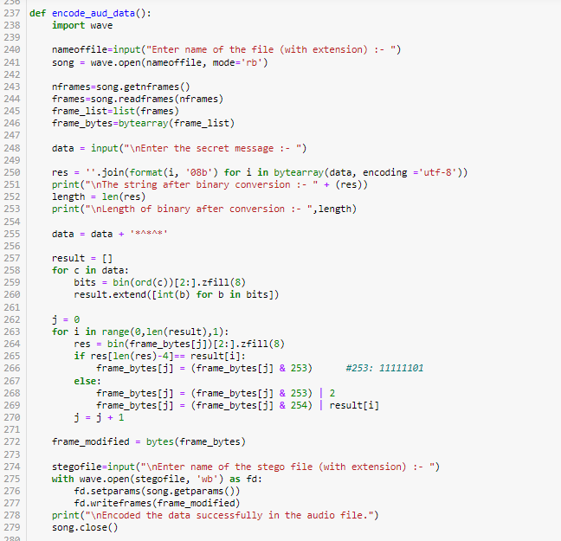
ENCODE

Slide 31
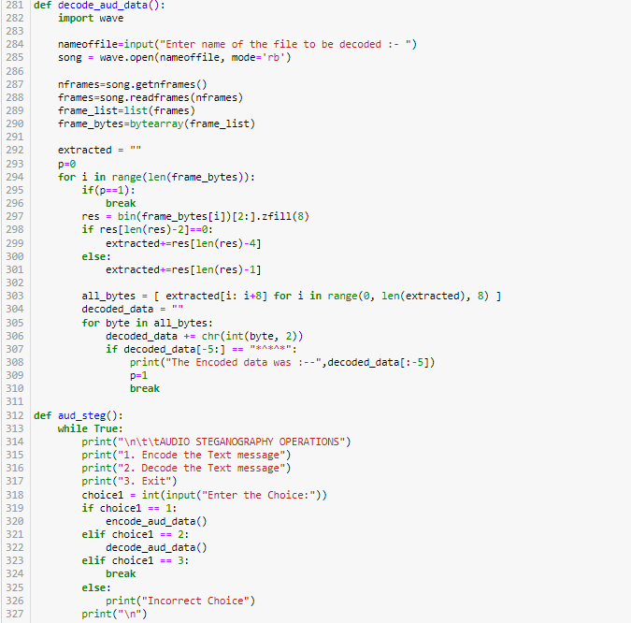
DECODE

Slide 32
VIDEO STEGANOGRAPHY (USING RC4 ALGORITHM)

Slide 33
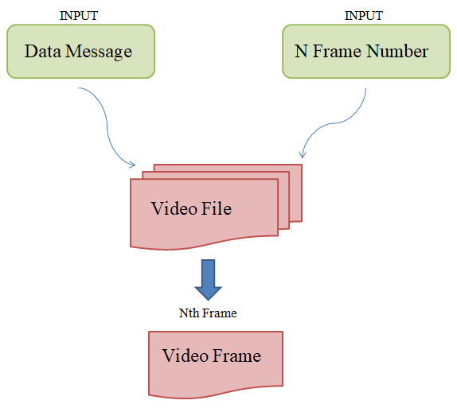

Slide 34
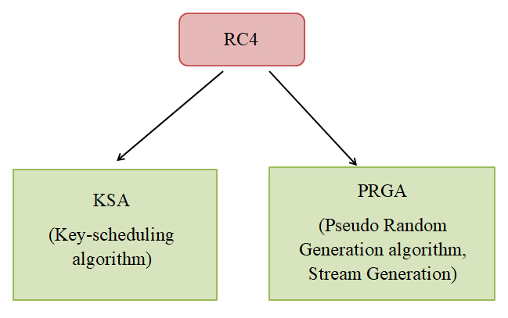

Slide 35
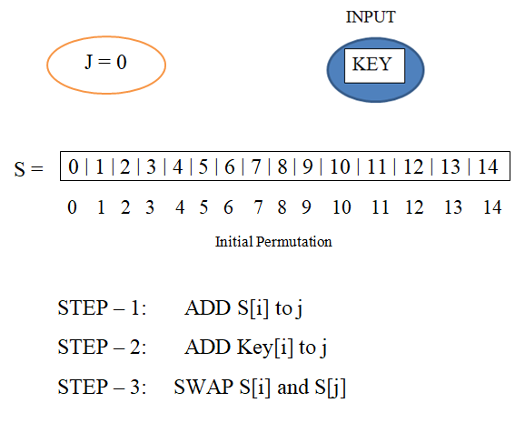
Ksa (Key-scheduling algorithm)

Slide 36
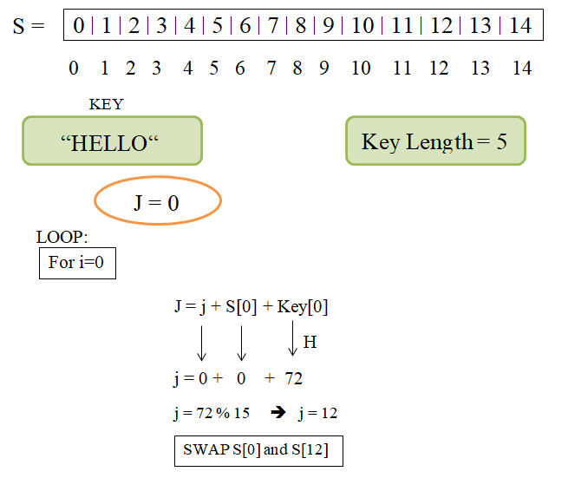

Slide 37
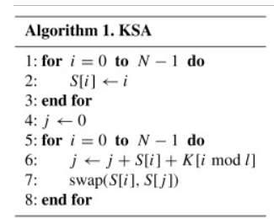
Algorithm format

Slide 38
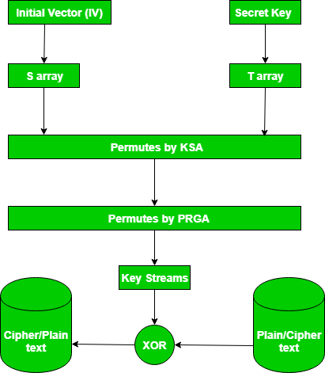

Slide 39
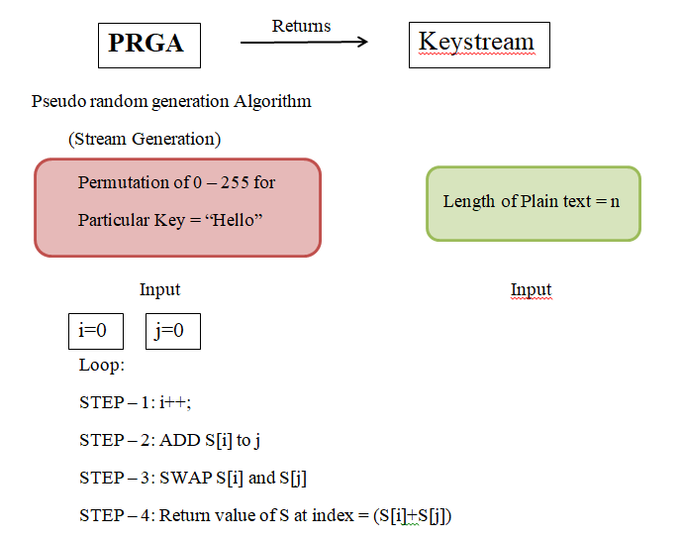
PRGA (Stream generation)

Slide 40
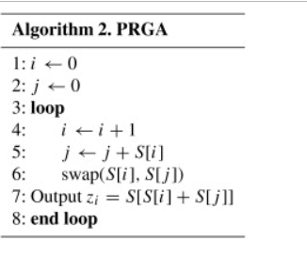
Algorithm format

Slide 41
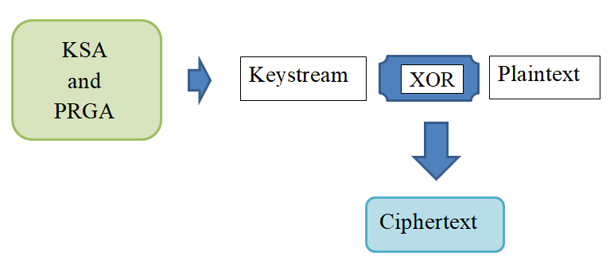
RC4 ENCRYPTION

Slide 42
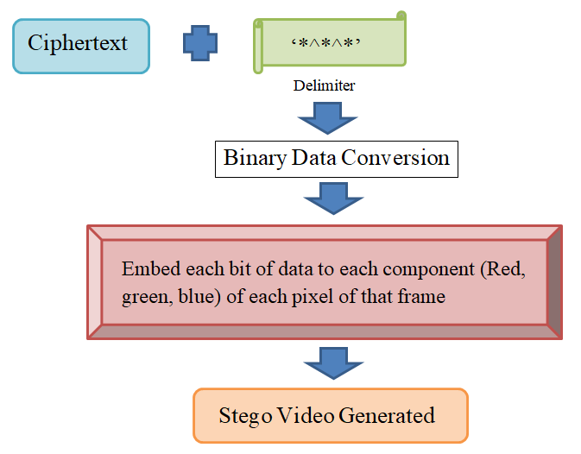

Slide 43
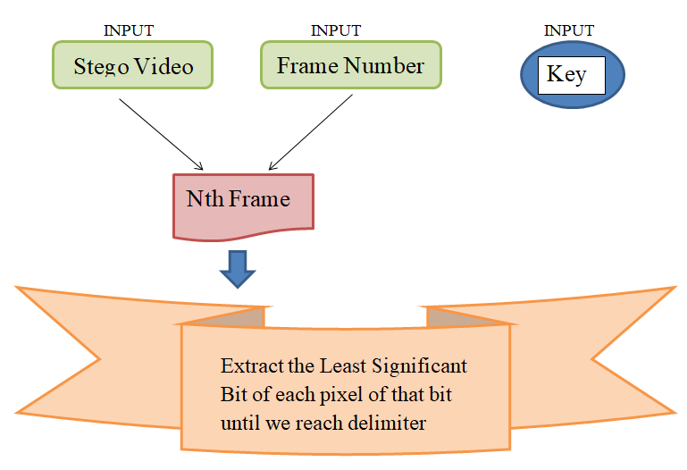
DECODE

Slide 44
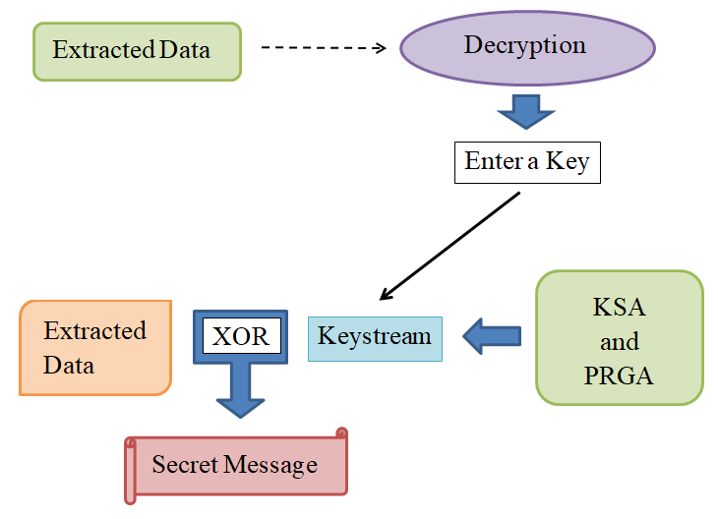

Slide 45
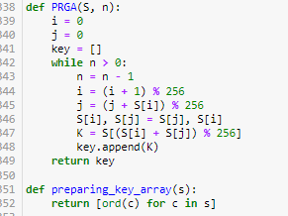
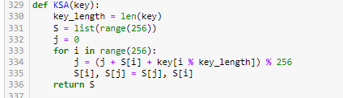
KSA AND PRGA

Slide 46
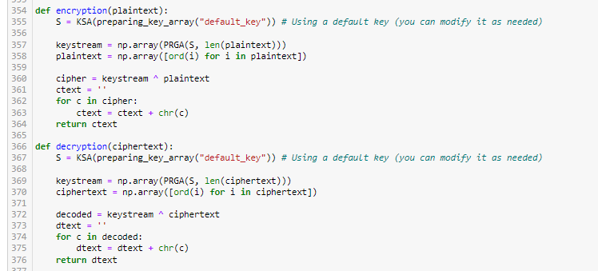
ENCRYPTION AND DECRYPTION

Slide 47
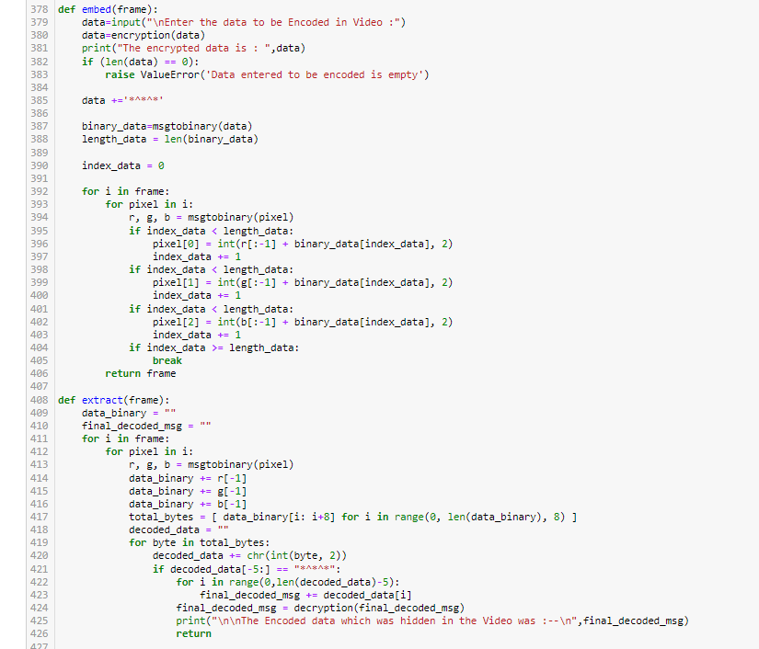
EMBED AND EXTRACT

